Slide 1
Marketing, promotion, and advertising, 2017
Branding

Slide 2

Branding is the key to identity

Slide 3
Marketing, promotion, and advertising, 2017
Irish Central Advertising campaign

Slide 4
Three Campaign Themes – 2 photos each – 6 ads linkd to our landing page
Embrace your Irish heritage
Join the voice of Irish America
Grow your Irish American Community

Slide 5
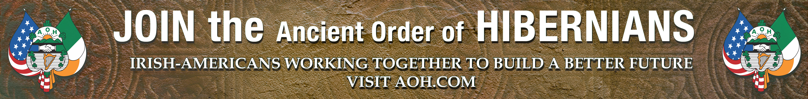
Banner ad

Slide 6
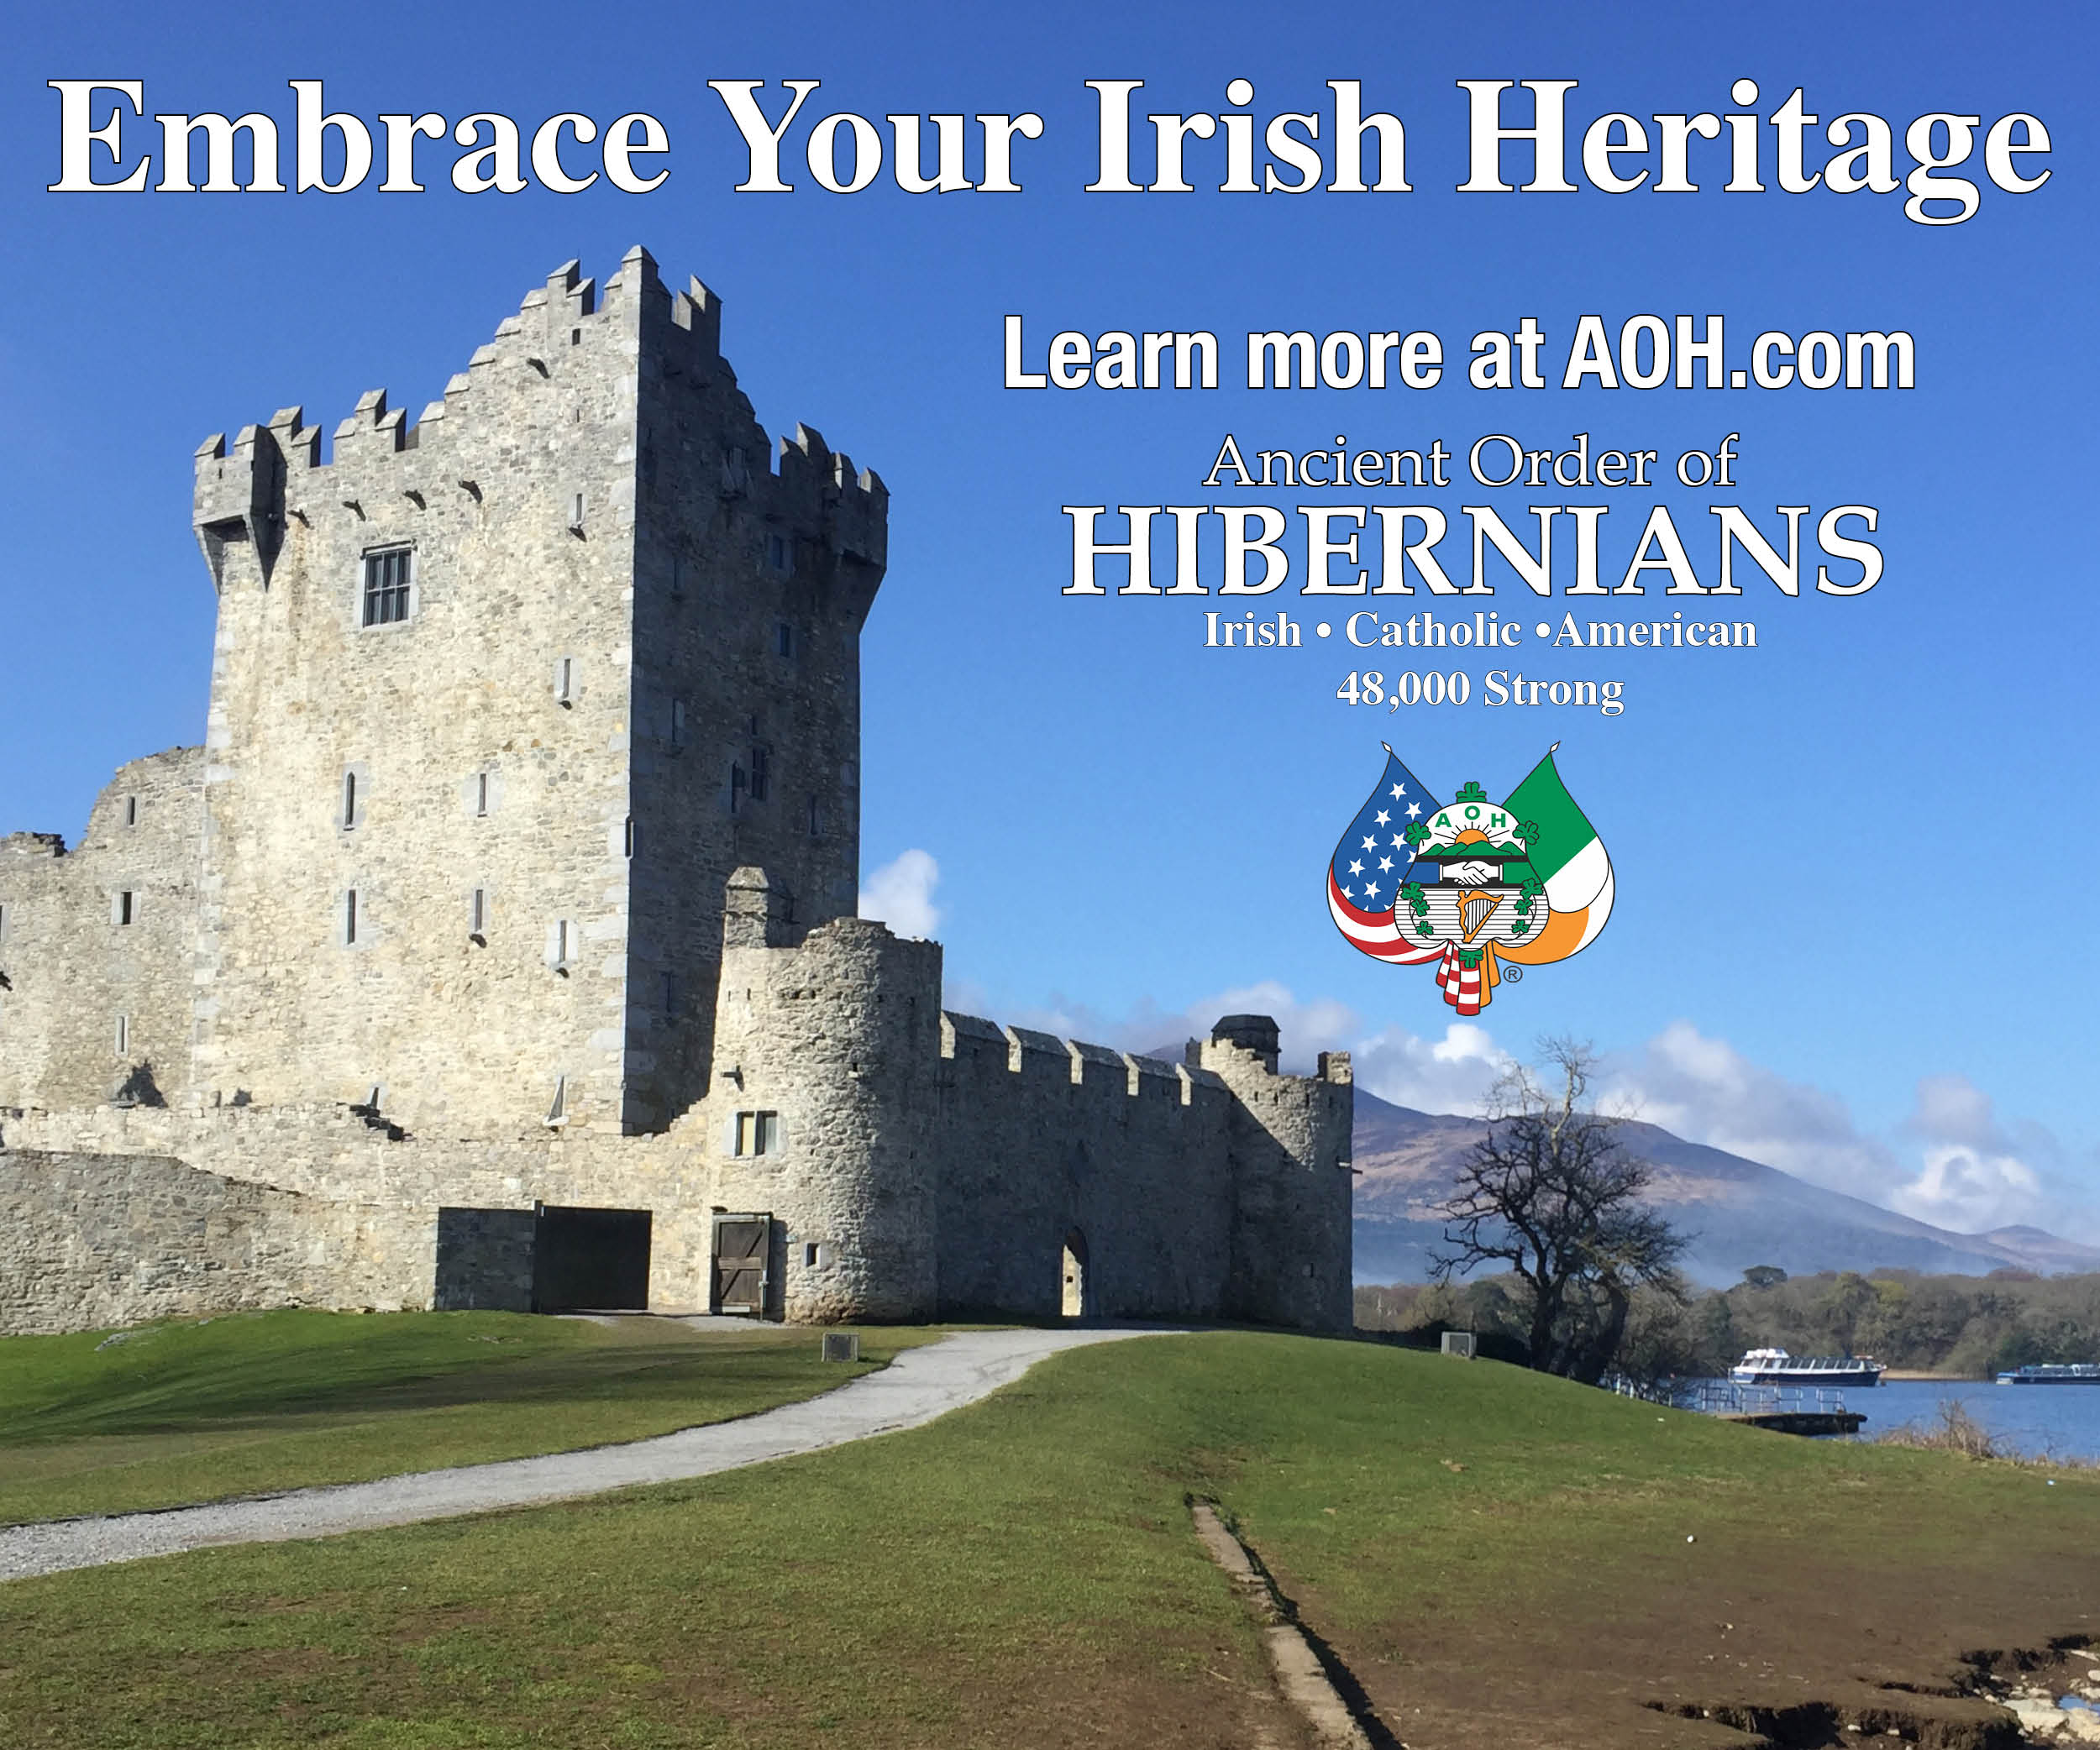

Slide 7
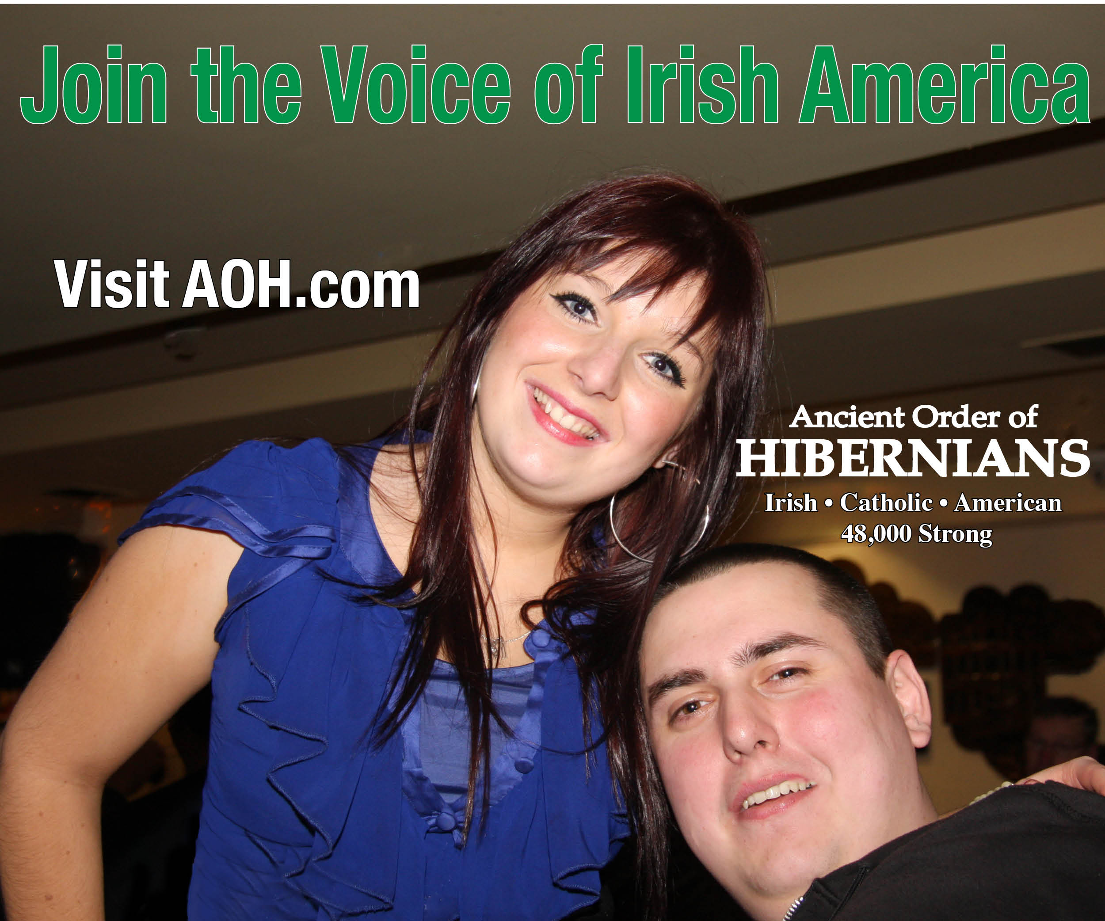

Slide 8
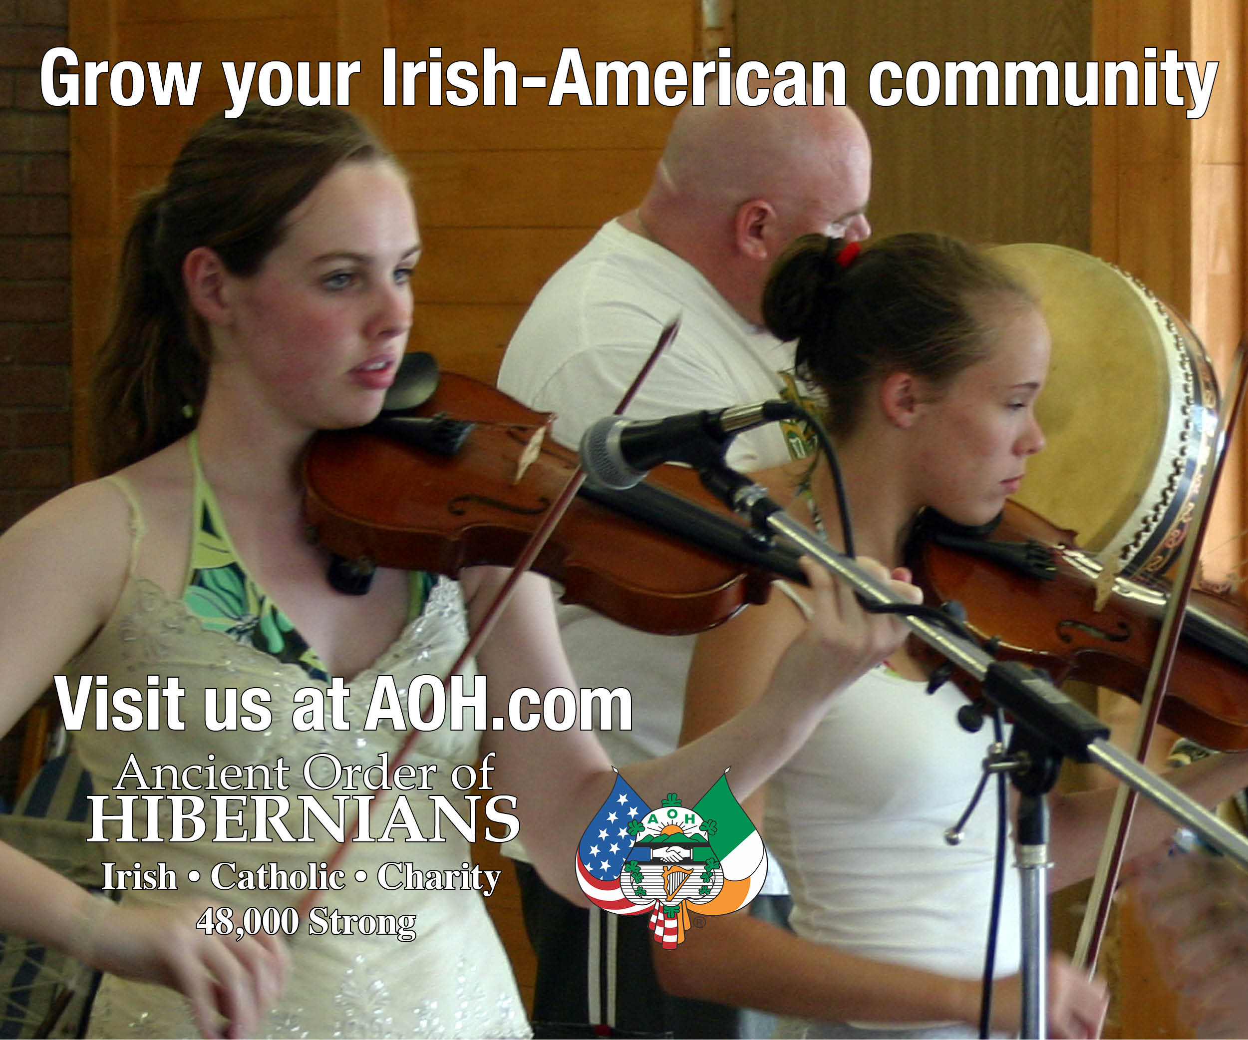

Slide 9
Landing page
When someone clicks on our ad – they will go to our landing page
  Forms will go to organizer, office, webmaster, vice president
AOH Landing Page

Slide 10
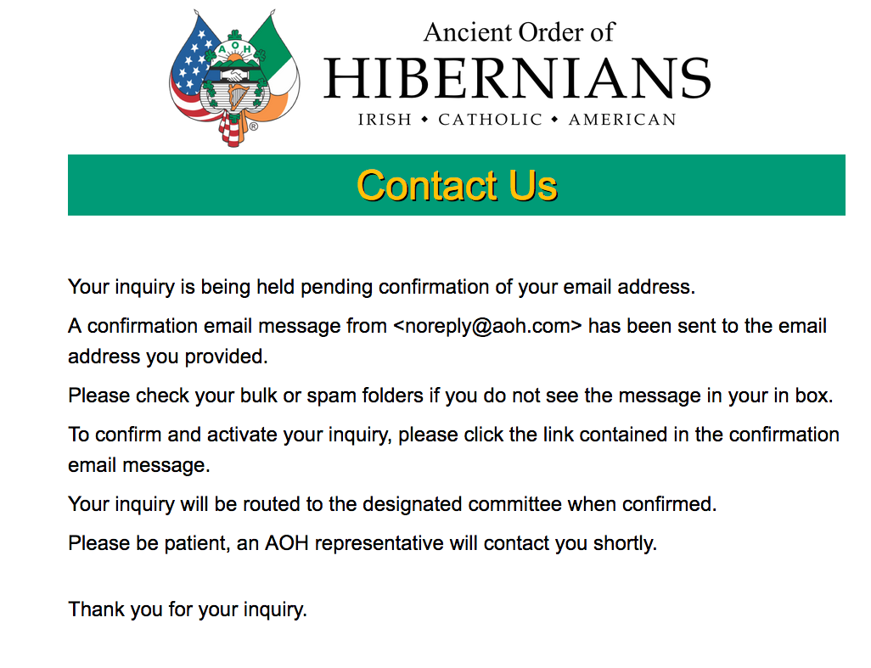

Slide 11
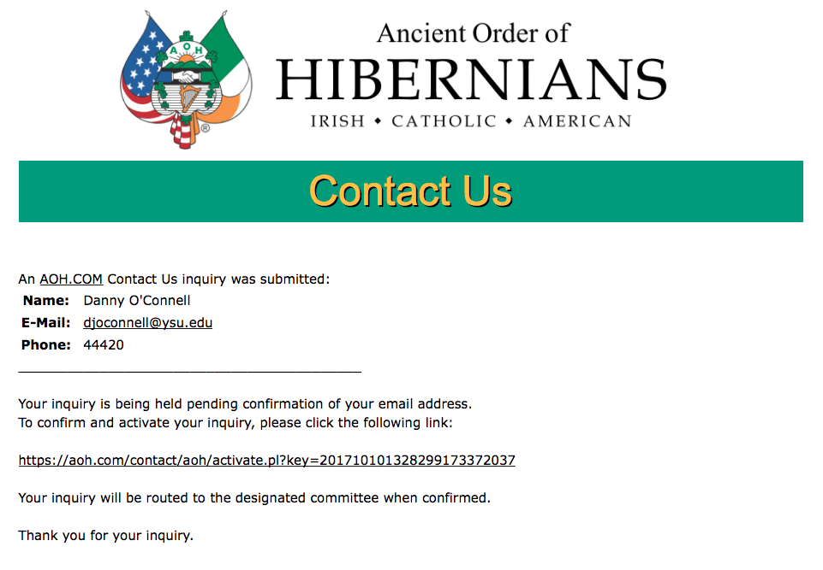

Slide 12
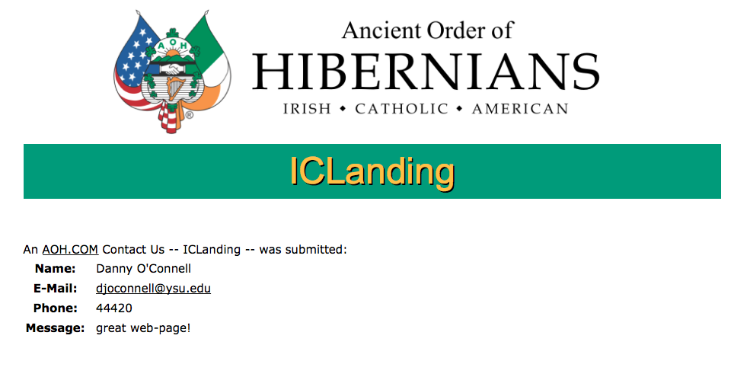

Slide 13
application
From the landing page, we can gather basic information or they can go to our application
The application will be the primary link on our new web page
  Completed application go to organizer, Office, Webmaster and vp
AOH New Application

Slide 14
Success =
Application
Local Recruiting of applicant
Vet applicant
Install applicant
Retain applicant

Slide 15
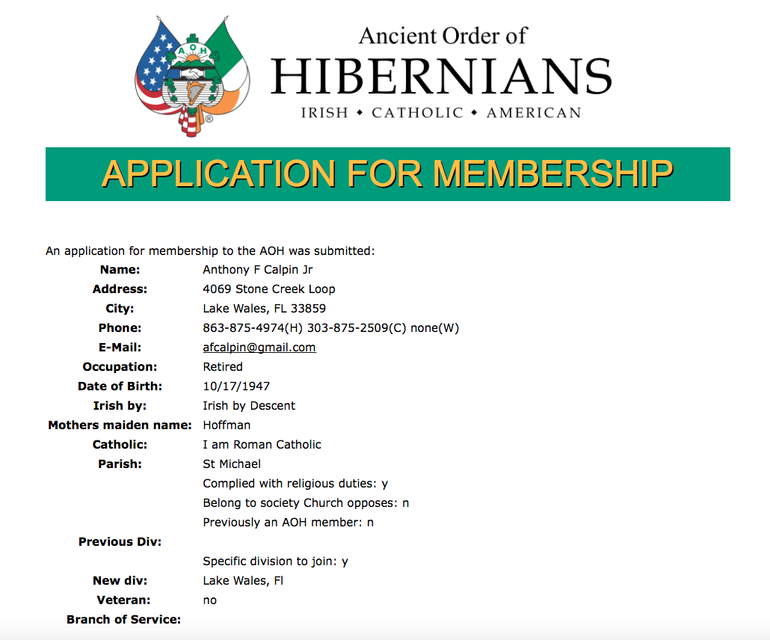

Slide 17
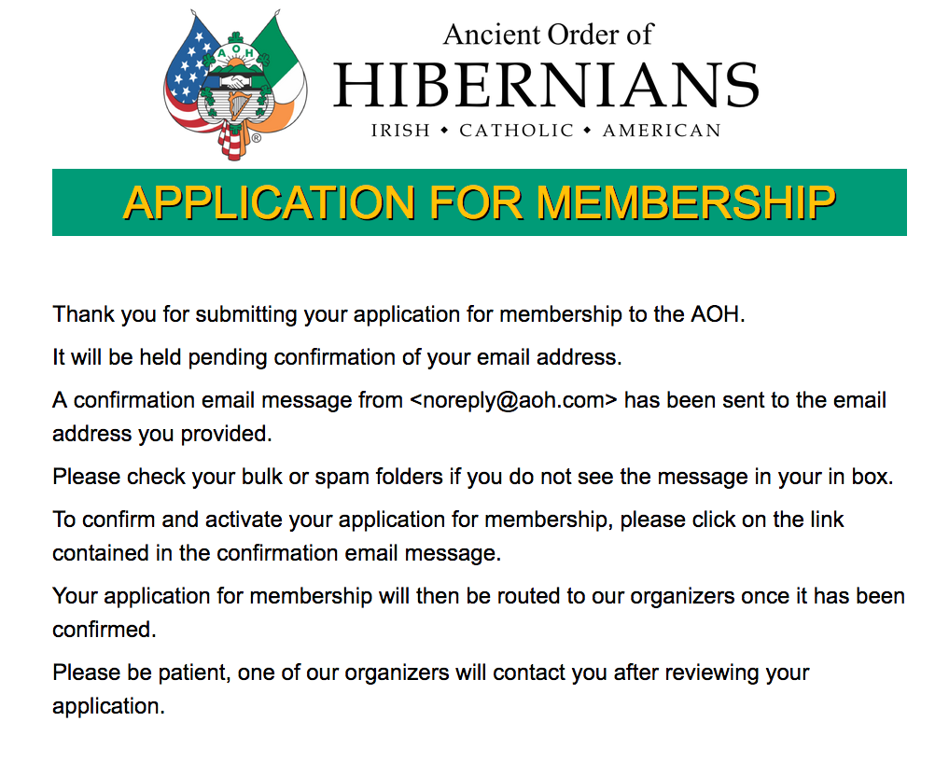

Slide 18
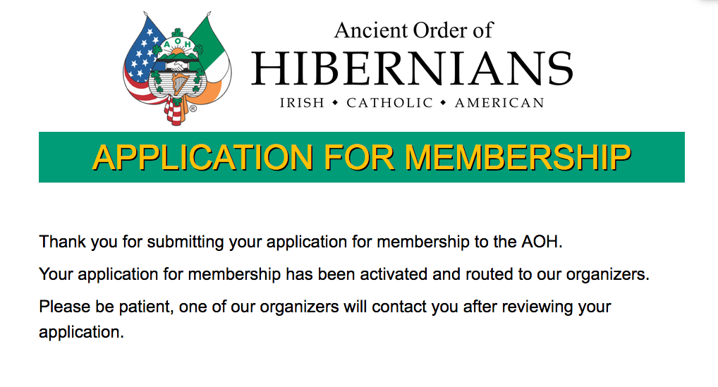

Slide 19
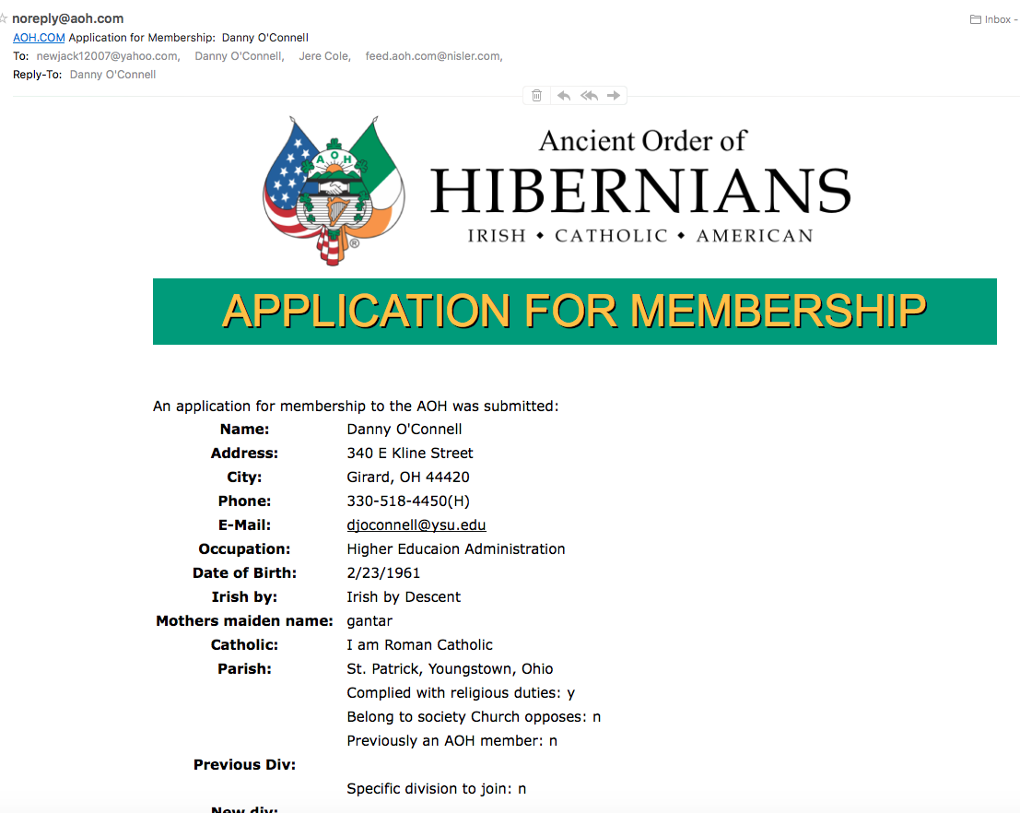

Slide 20
Marketing, Promotion, and advertising, 2017
Social Media Guide

Slide 21
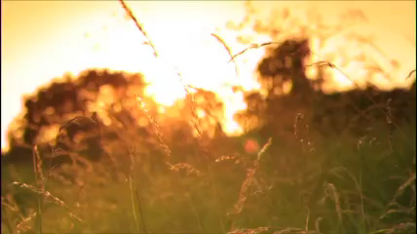
Video content

Slide 22
Social Media Guide
Stock AOH ads
How to promote to your local county
  More bang for your buck
How to make a local ad or video

